Slide 1


Study on global access to drinking water services

Slide 2

Context
Reason for the project
Our mission – To provide access to drinking water to everyone.
We recently requested funding from a donor.
He can finance one of our 3 key areas of expertise:
Service creation;
Service modernisation; or
Consulting
DWFA should be prepared to suggest a country to support based on the chosen area of expertise.
Tableau dashboard – to identify the best countries to support based on each area of expertise.

Slide 3

Part 1 – Mock-up and Blueprint

Slide 4
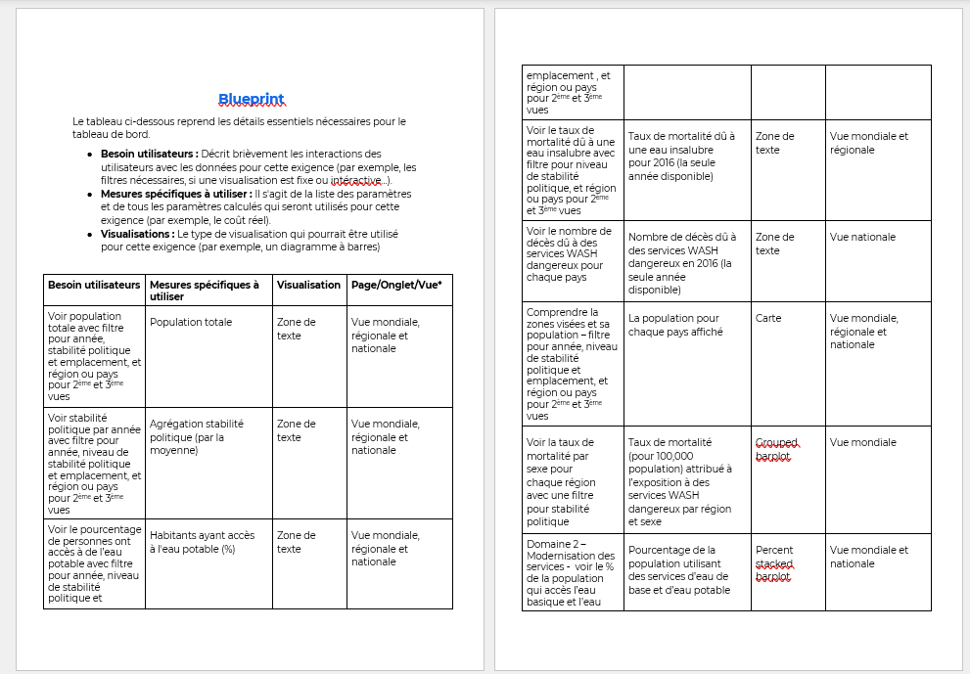
Blueprint
Construct a blueprint that explains:
User requirements
Specific measurements to use
Visualisation necessary
The pages they will be on(world, region or country)

Slide 5
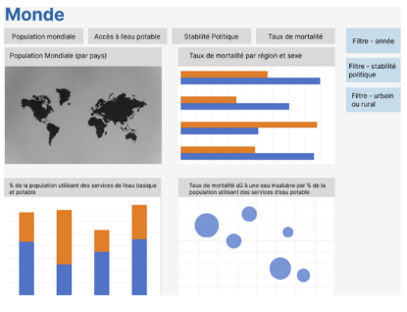
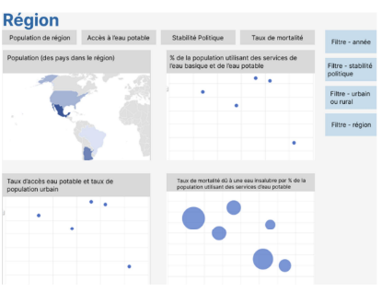
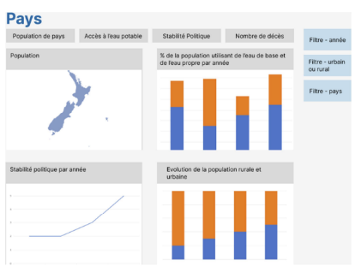
The blueprint and mock-up
Construct a mock-up for each view:
World
Region
Country
Use at least one time:
A line plot
A scatter plot
A grouped barplot
A stacked barplot
Include the following filters:
Quantitative
Qualitative
Time
Geographic

Slide 6

Part 2 – Dashboard Creation

Slide 7


Merge the files
RegionCountry.csv
Population.csv
BasicAndSafelyManagedDrinkingWaterServices.csv
MortalityRateAttributedToWater.csv
PoliticalStability.csv

Slide 8

Create the graphs and indicators
Use the blueprint to create the graphs and indicators
Create calculated fields for:
Population
% of population living in urban areas
% of urban population with access to drinking water
Add indicators and graphs to dashboards
Add filters for each graph/indicator

Slide 9

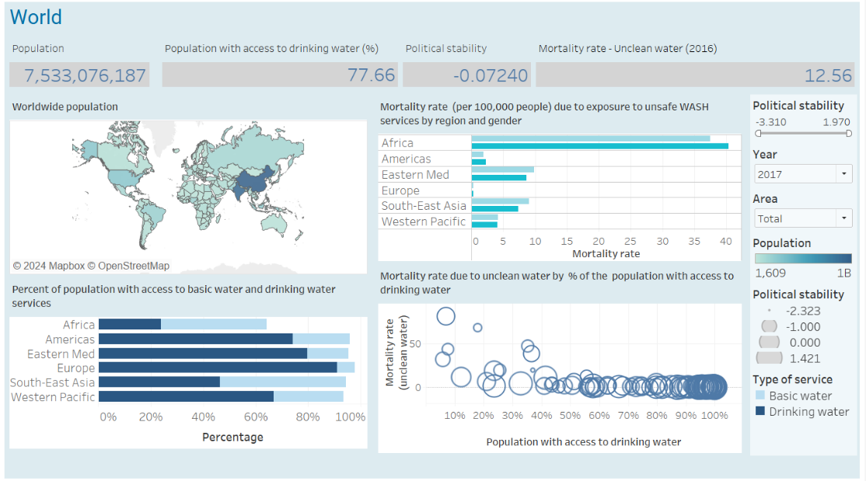
World view

Slide 10

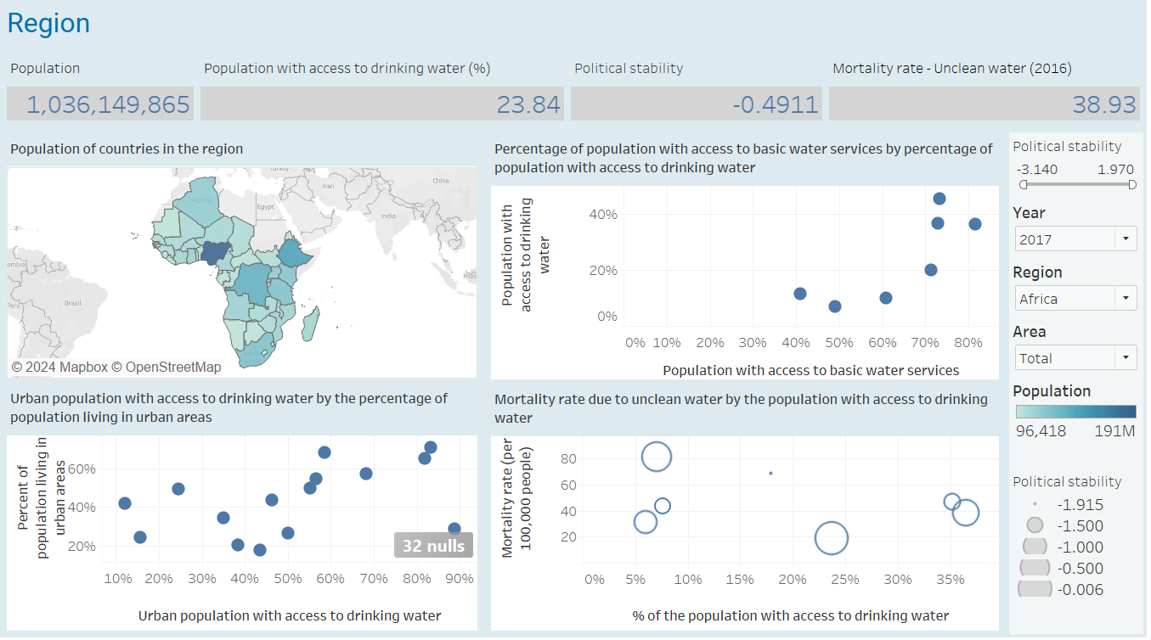
Region view

Slide 11

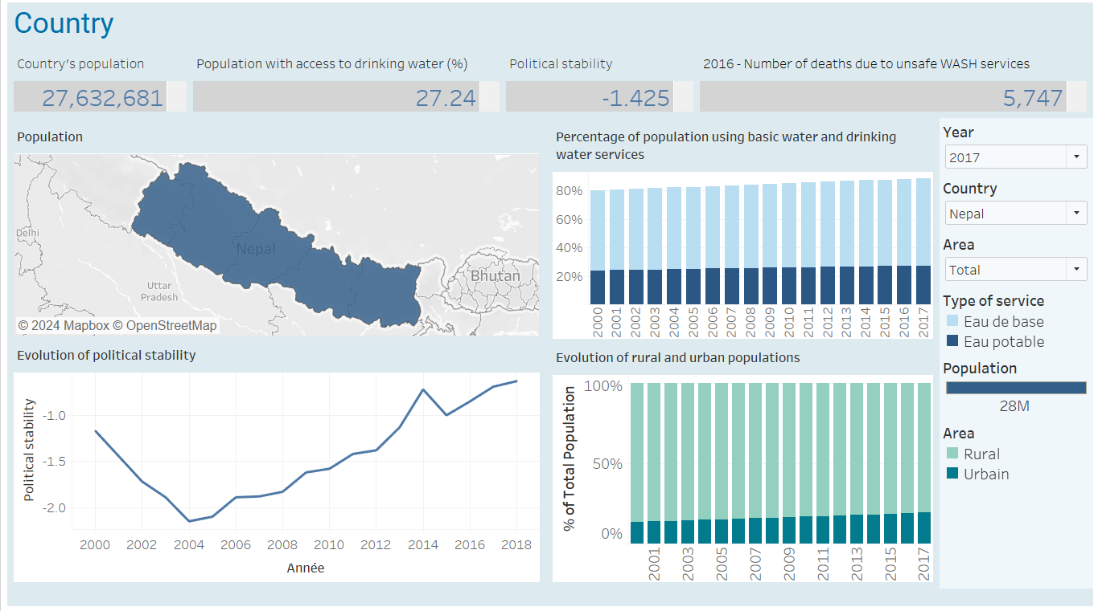
Country view

Slide 12
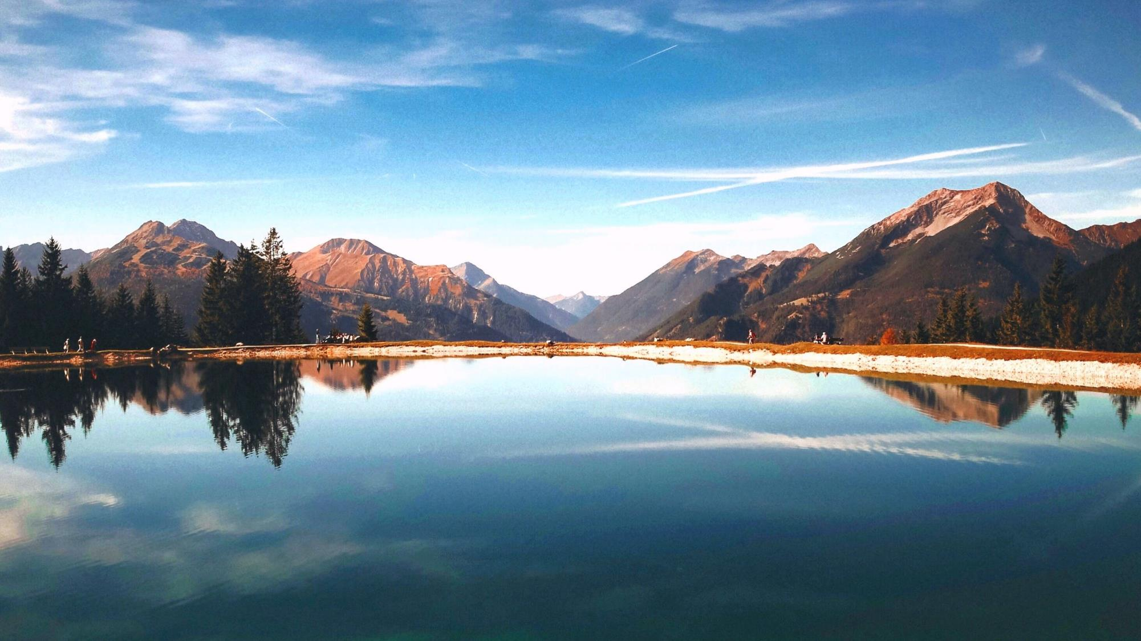
Part 3 – Key themes

Slide 13

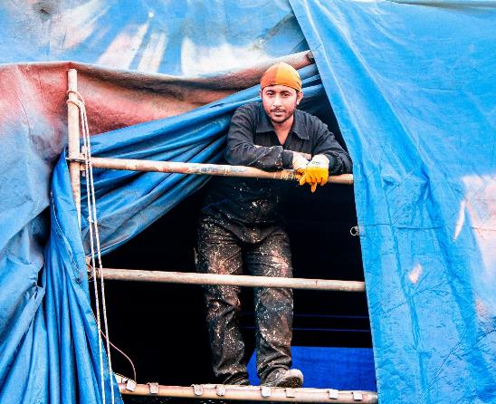

Three areas of expertise
Service creation
Service modernisation
Consulting

Slide 14

Area 1 – Service creation
Rural and urban populations – different work required
The development of urban areas allows more people to benefit from new infrastructure.
Nigeria - a good candidate for the creation of new services.
47 percent of Nigeria's population is urban
Only 24 percent of its urban population has access to drinking water
The urban population continues to grow

Slide 15
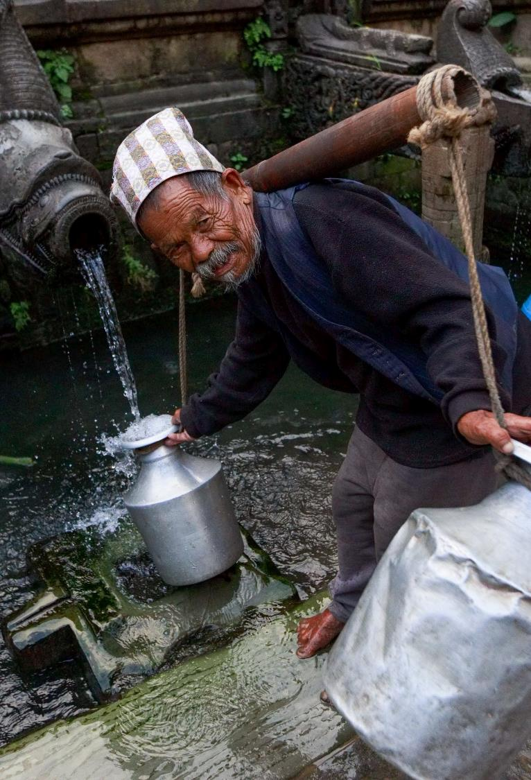
Area 2 – Service modernisation
Africa and South Asia are most in need of service modernization.
Nepal and Nigeria – high level of access to basic water, low level of access to drinking water.
Access to drinking water has increased by around 30% in Nigeria but only 9% in Nepal.
Nepal – the best candidate for service modernization
Political stability – relatively high

Slide 16
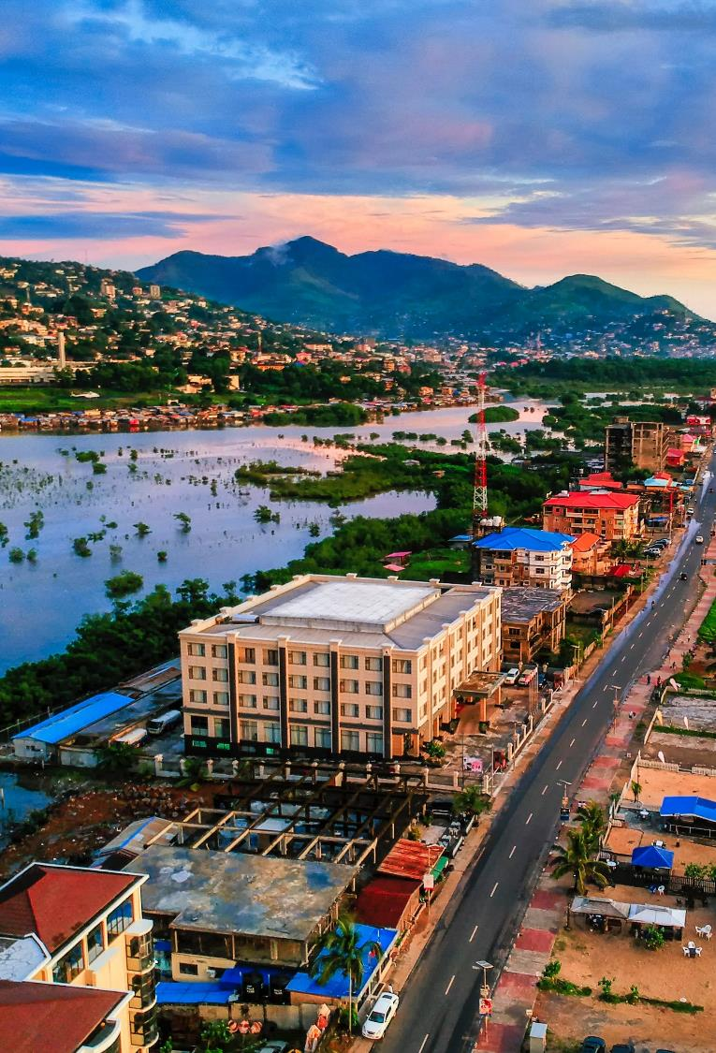
Area 3 – Consulting
It is important that the country is quite stable politically
Sierra Leone – consulting will be useful for this country
A good level of political stability
High mortality rate (81.29)
The urban population continues to grow
Only 9.92% of the population has access to drinking water.

Slide 17




Conclusion
Service creation
Nigeria. A relatively large urban population, but a large part of this population does not have access to drinking water.
Service modernisation
Nepal. A fairly high level of access to basic water services, but a need for services for access to drinking water.
Consulting
Sierra Leone. Good political stability, but a high mortality rate and a low level of access to drinking water.

